Slide 1
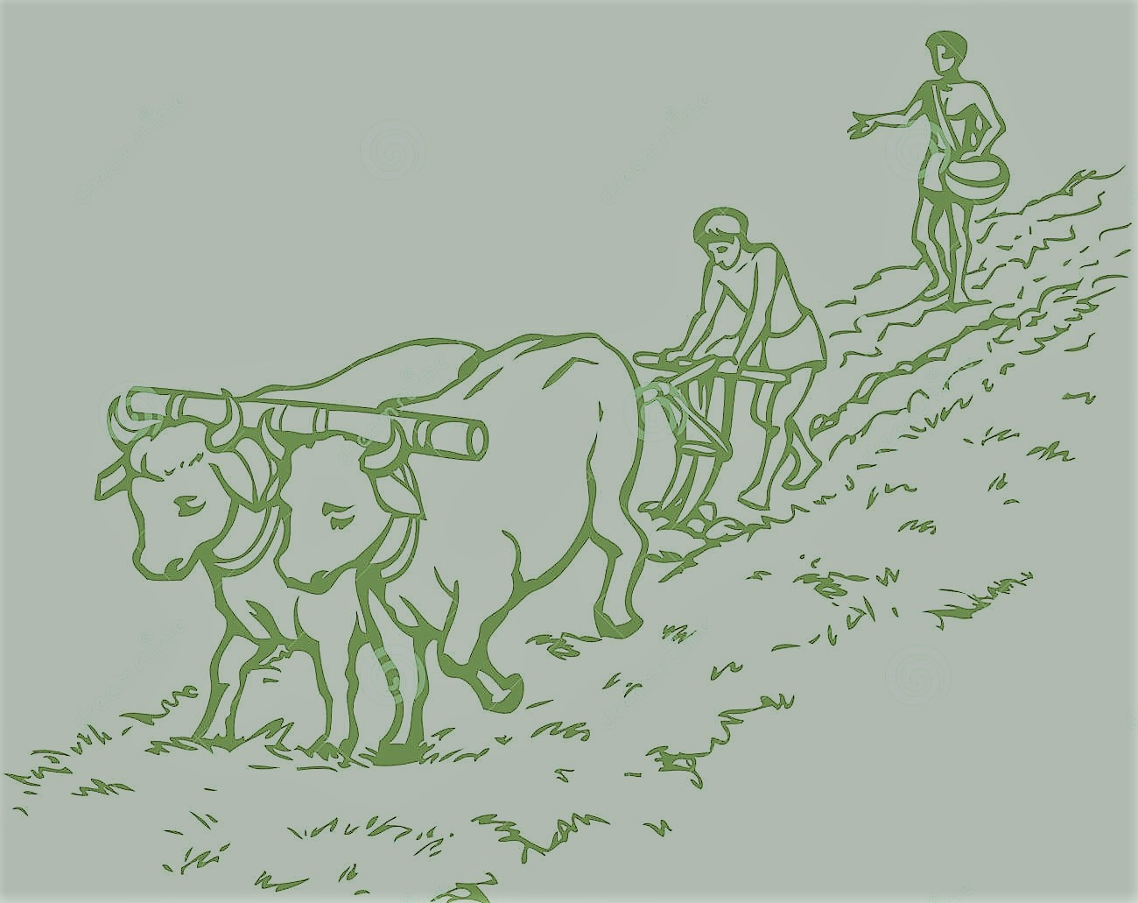

INTELLIGENT FARMING ON WHEELS
HELPCLUB:-T.VINOD REDDY
A.SAI KARUN
L.SAI KIRAN
P.S.NEHA SRI
G.NIHARIKA DEVI.

Slide 2
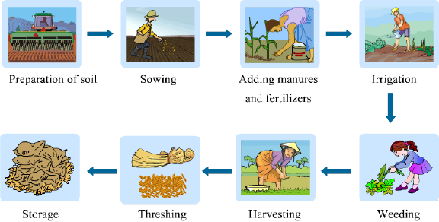
AGRICULTRE ?

Slide 3
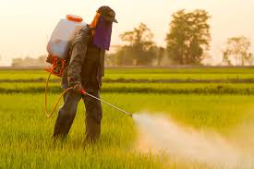
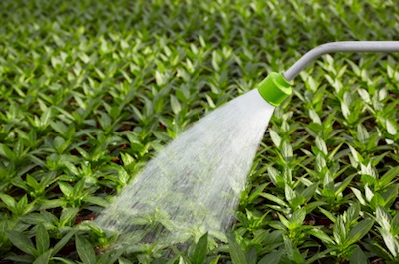
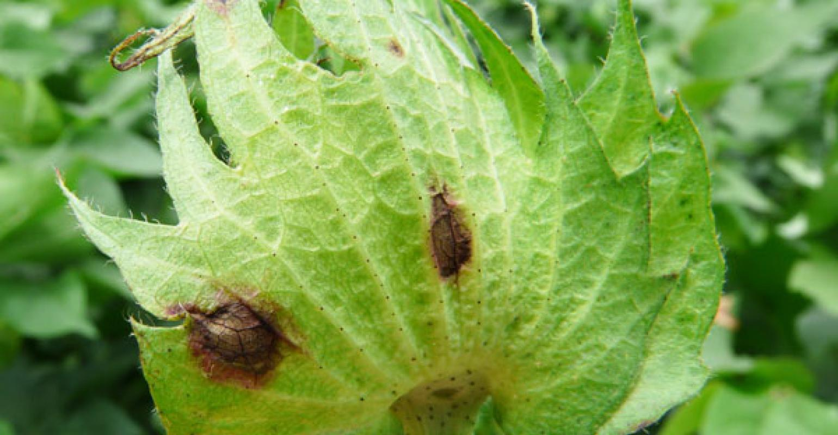
AREA OF OUR INTEREST:-
Adding manures and fertilizers.
Irrigation.
*Disease detection.

Slide 4
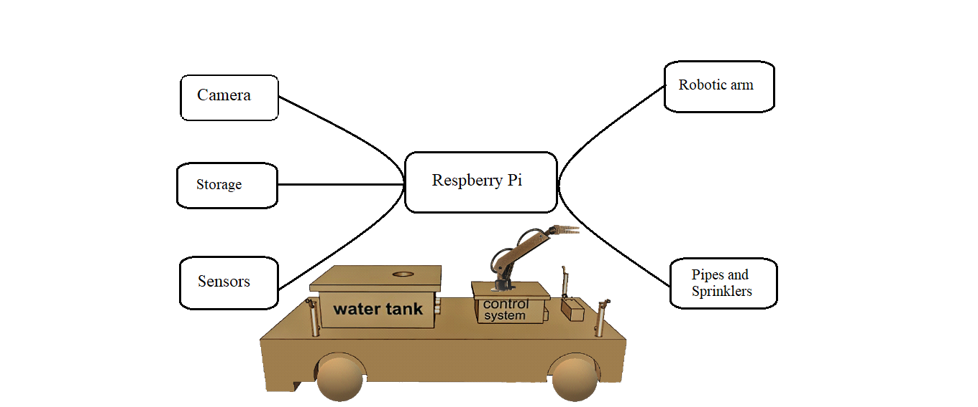
SOLUTION:
Project profile describes smart farming which includes watering plants, giving protection to plants
by fertilizers and pesticides, eliminating weed crops , smart sensor monitoring(i.e controlling
crop growth, disease, temperature, humidity measurements) using AI and IOT.
Intelligent Farming uses:
*Raspberry pi
Language is Python
Sensors
Robotic arm, Motors and some extra equipments.
INTELLIGENT FARMING ON WHEELS
How on WHEELS?
PROBLEMS :
Is farmer a Multi tasker?
The time taken by the farmer to water, fertilize, remove weed crop is?
Labour and the man power required is ?
Answer :JUMP SOLUTION.
“OUR VEHICLE TAKES A ROLE OF HERO IN INTELLIGET AGRICULTURE”

Slide 5
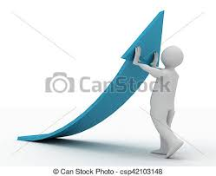
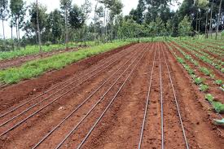
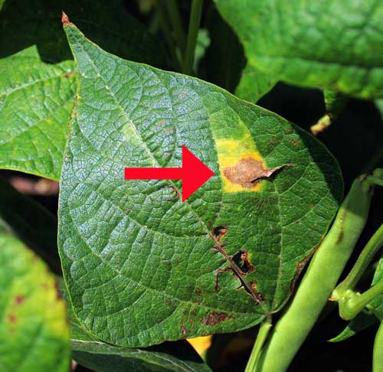
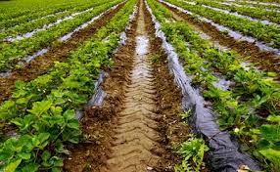
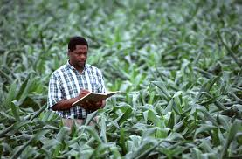
PROBLEMS:-
Labour increases.
Wastage of water.
*Delay in Disease Recoginition.
No proper water & pesticides supply.
*No proper monitoring.

Slide 6
(PROBLEMS)
SOLUTIONS:-
INCREASE IN LABOUR
SMART AGRICULTURE VEHICLE
WASTAGE OF WATER
ADEQUATE WATERING TO PLANTS
NO PROPER USAGE OF PESTICIDES
DEPENDING ON HELTHINESS OF CROP
* NO PROPER MONITERING
LIVE MONETERING THROUGH WIFI
MODULE

Slide 7

THINKING ABOUT WHAT TO DO NOW?

Slide 8
HARDWARE AND SOFTWARE INVOLVED:-
ROBORTIC ARM(SERVO MOTORS)
TEMPERATURE AND HUMIDITY SENSOR(NODEMCU DTH11)
AURDINO PROGRAMMING
DC MOTORS
WATER PUMP(submergable)
*RASPBERRY PI(for disease recognition using ‘ picam ’)

Slide 9
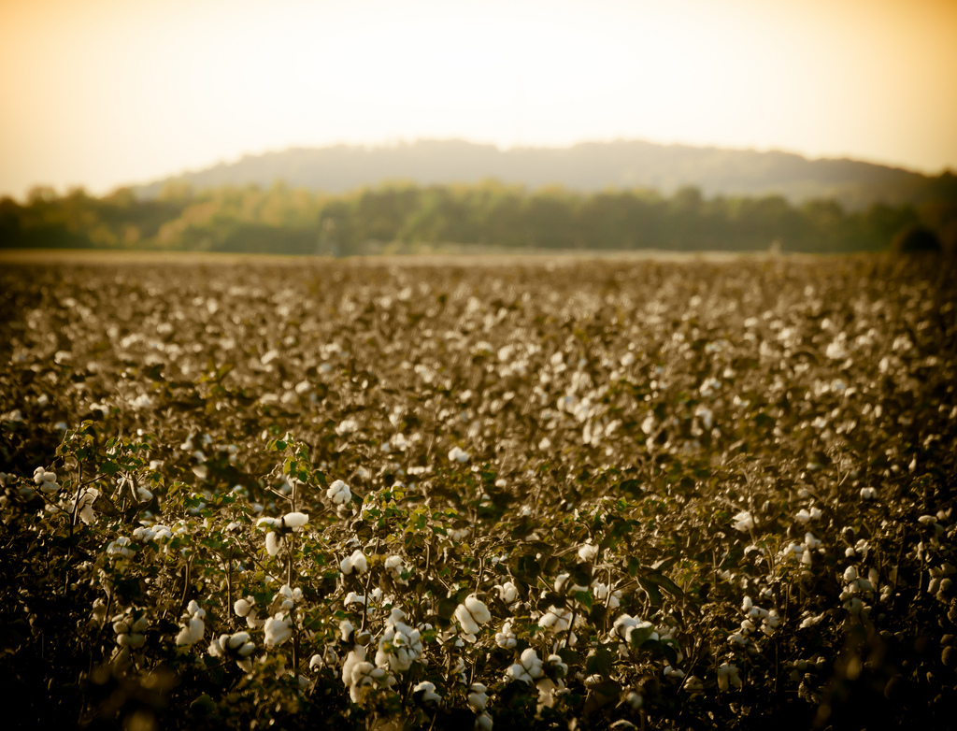
FUTURE….
Our future plan is to develop ‘disease detection’ by K-mean clustering.
Agriculture was the past,
Agriculture is the present,
Agriculture is the future….

Slide 10
THANK YOU…

